Slide 1
Steps of RAT analysis (Source analysis)

Slide 2
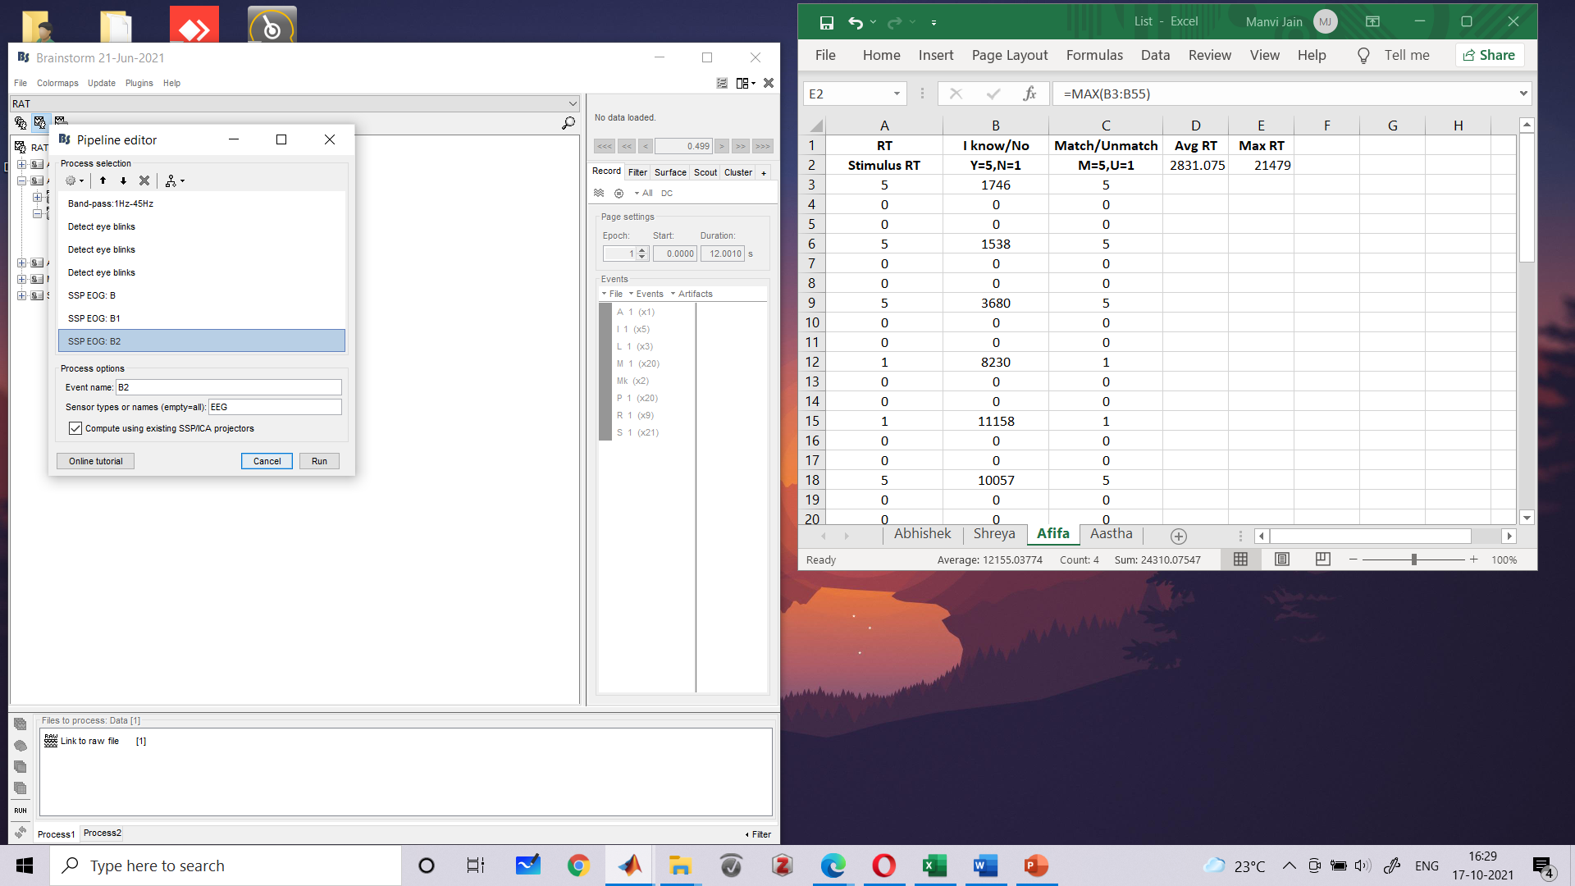

Slide 3
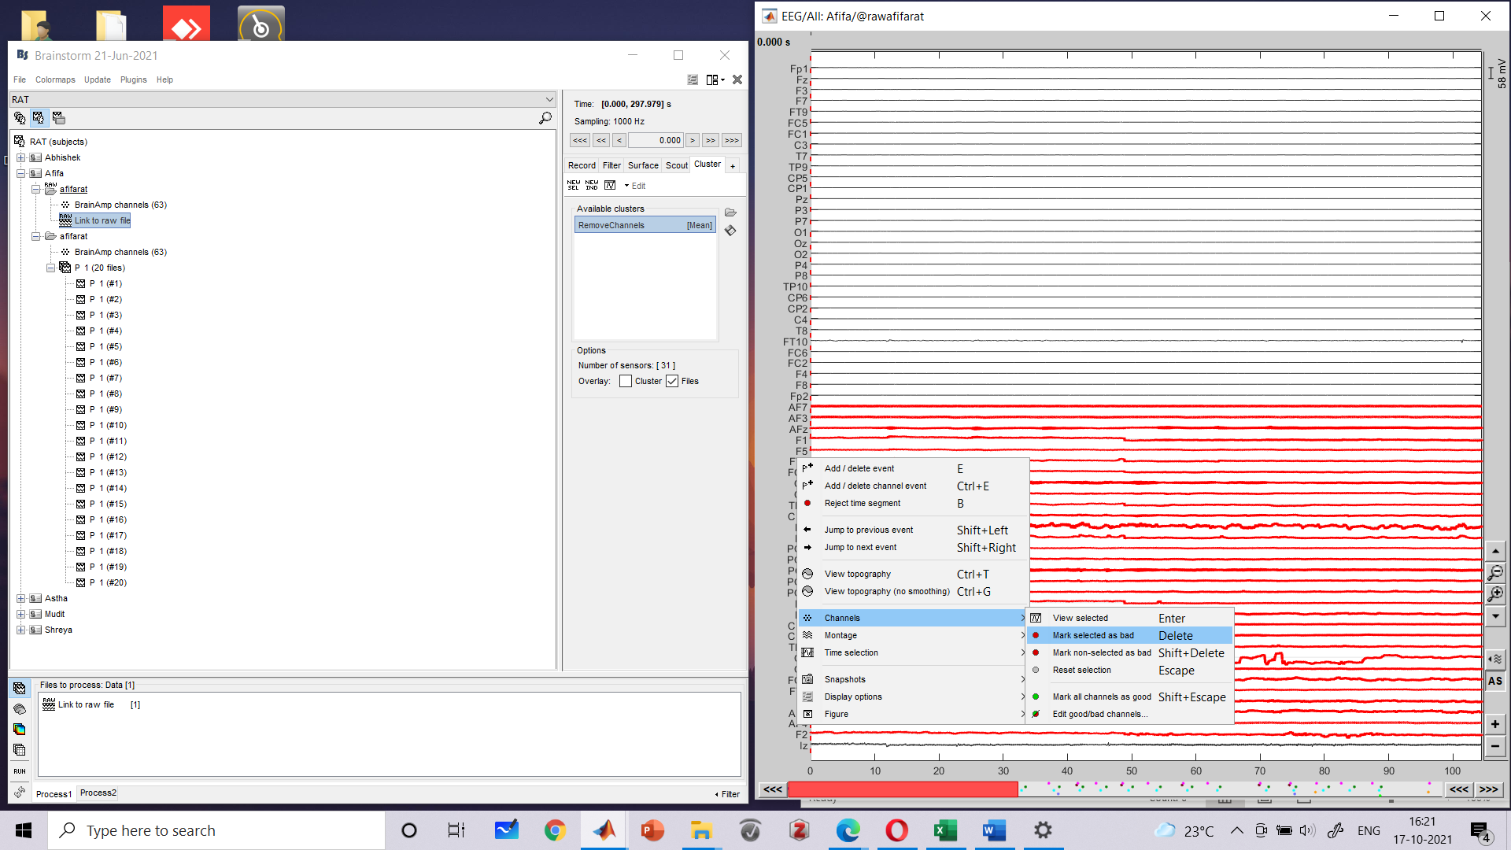

Slide 4
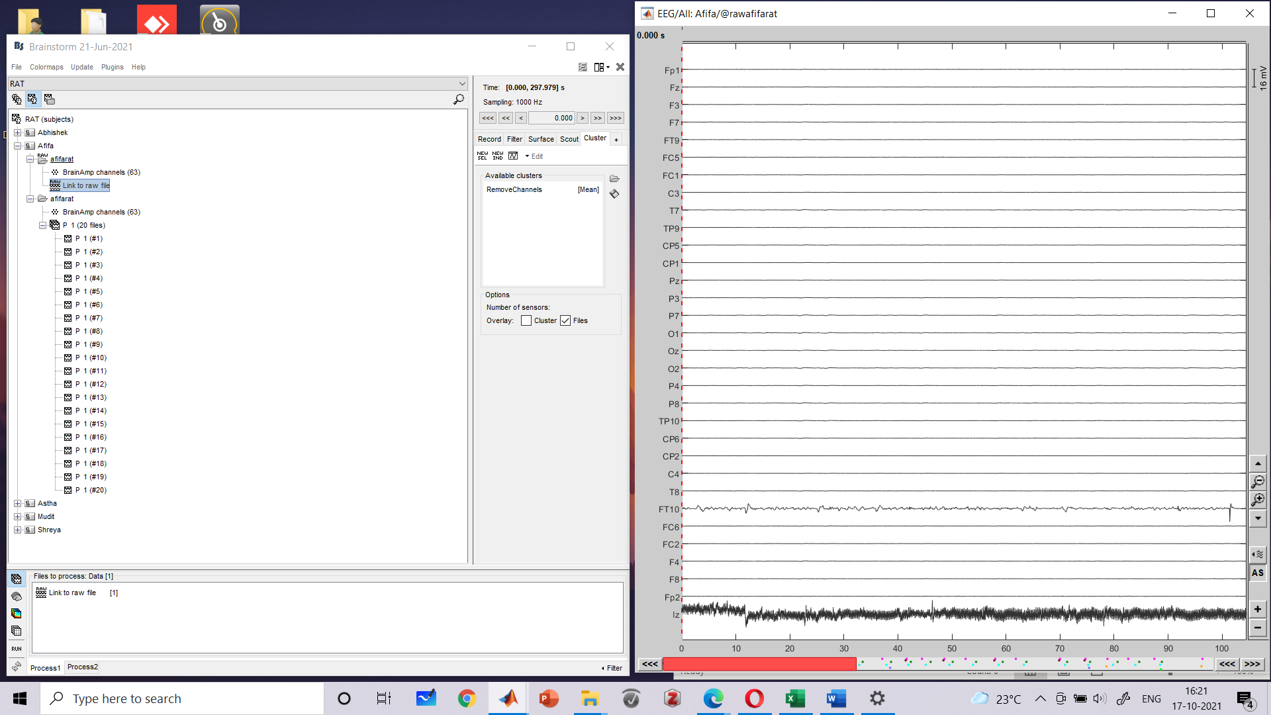

Slide 5
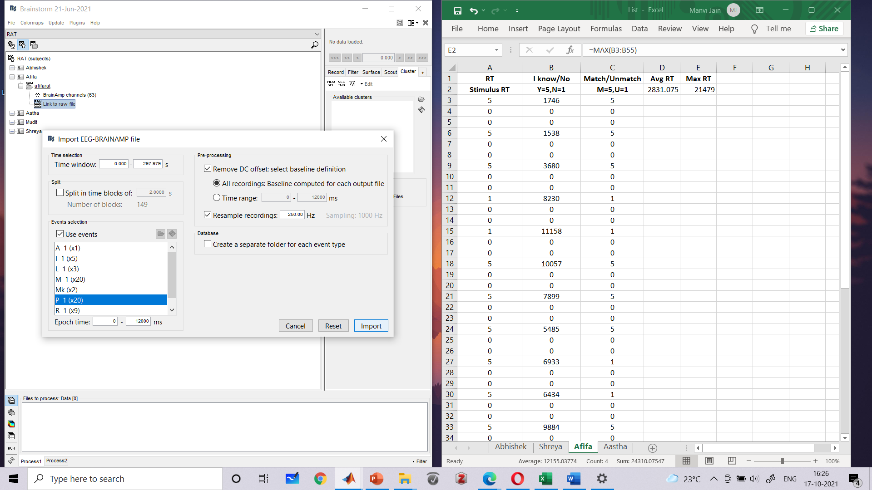

Slide 6
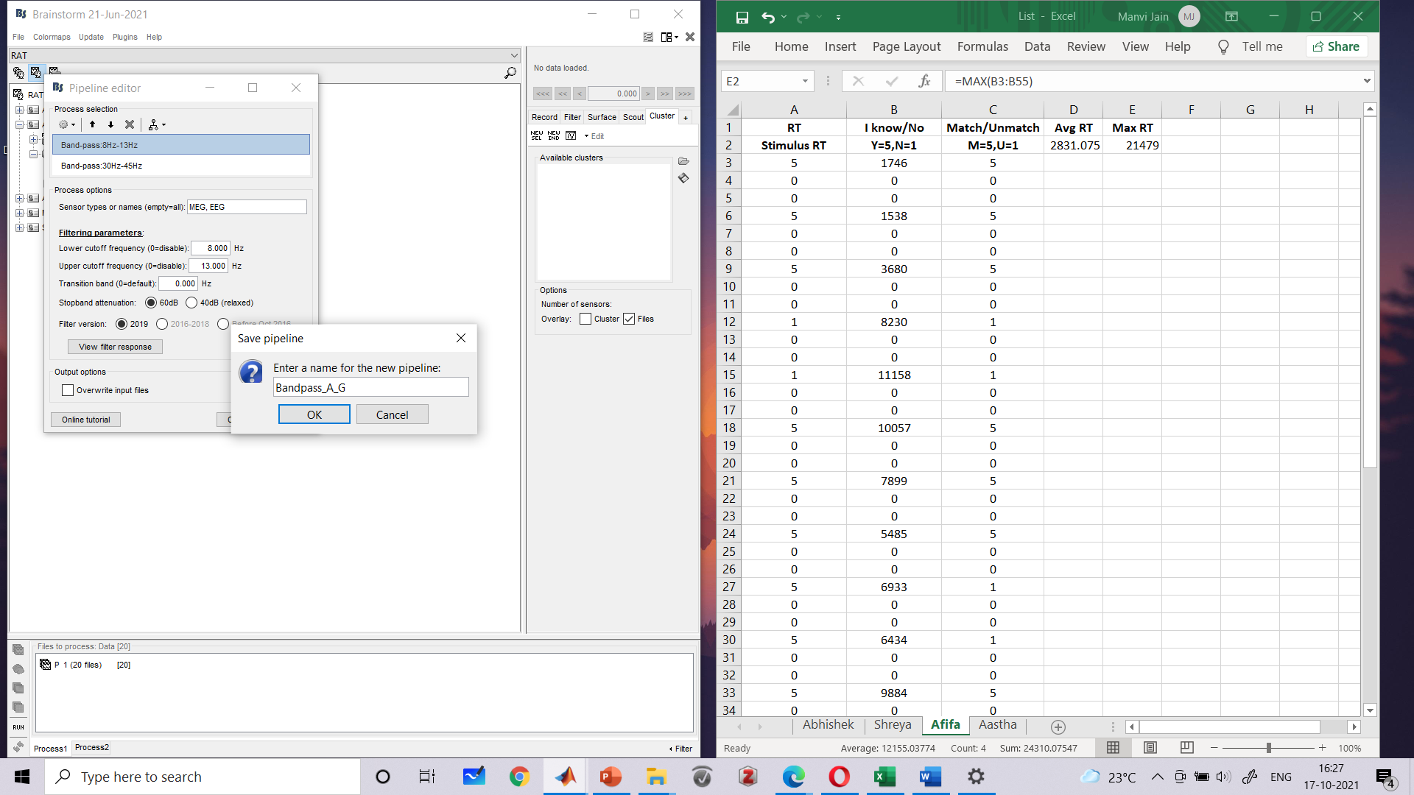

Slide 8
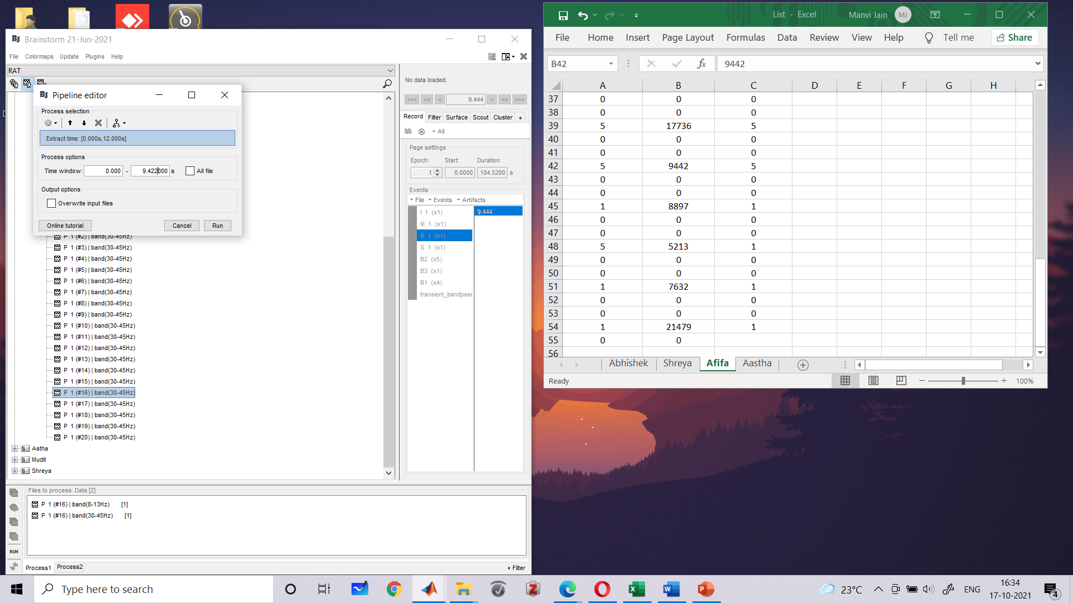

Slide 9


Slide 10
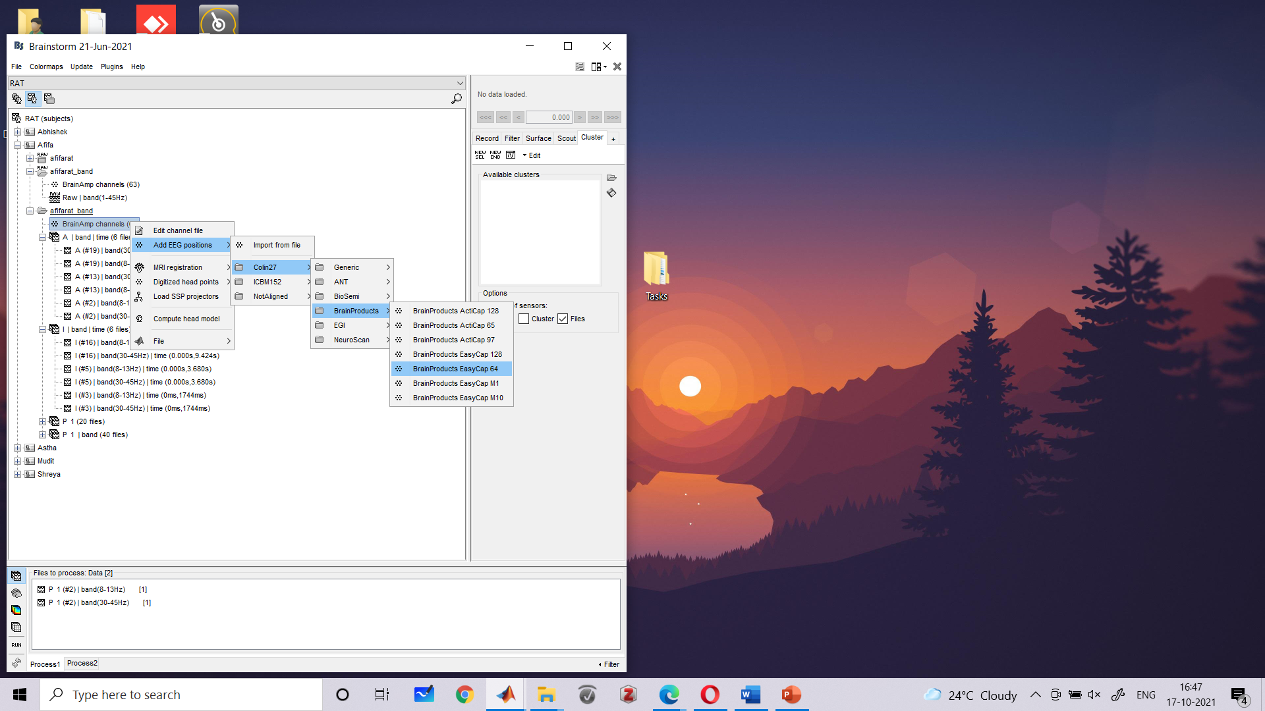

Slide 11
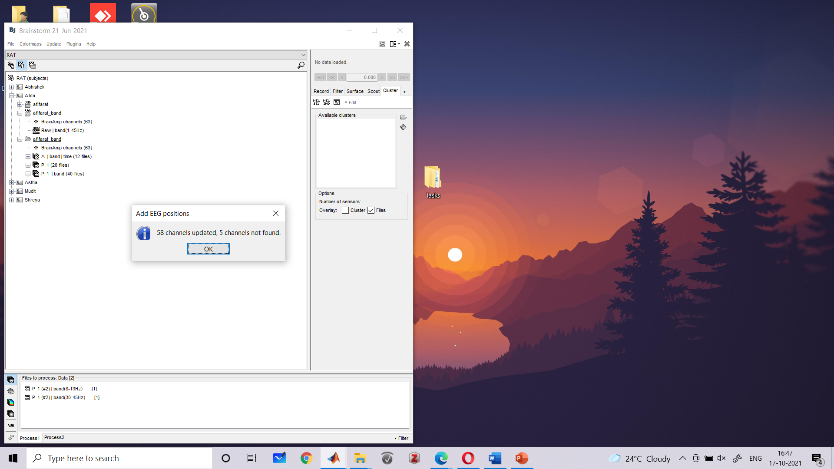

Slide 12


Slide 13
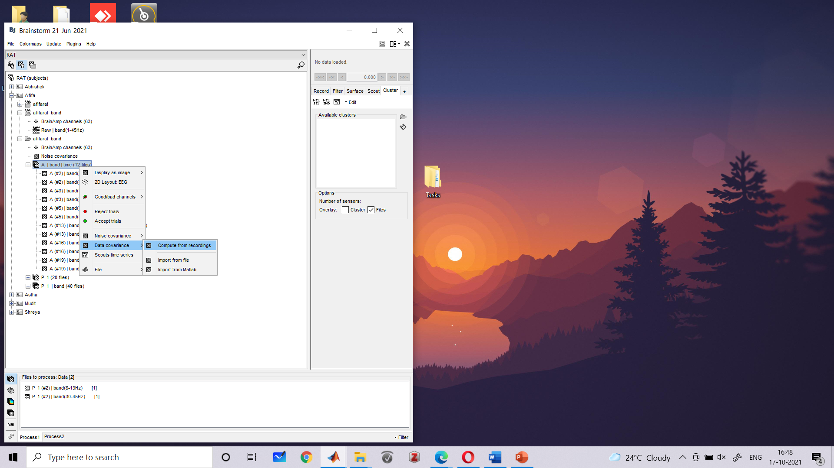

Slide 14


Slide 15
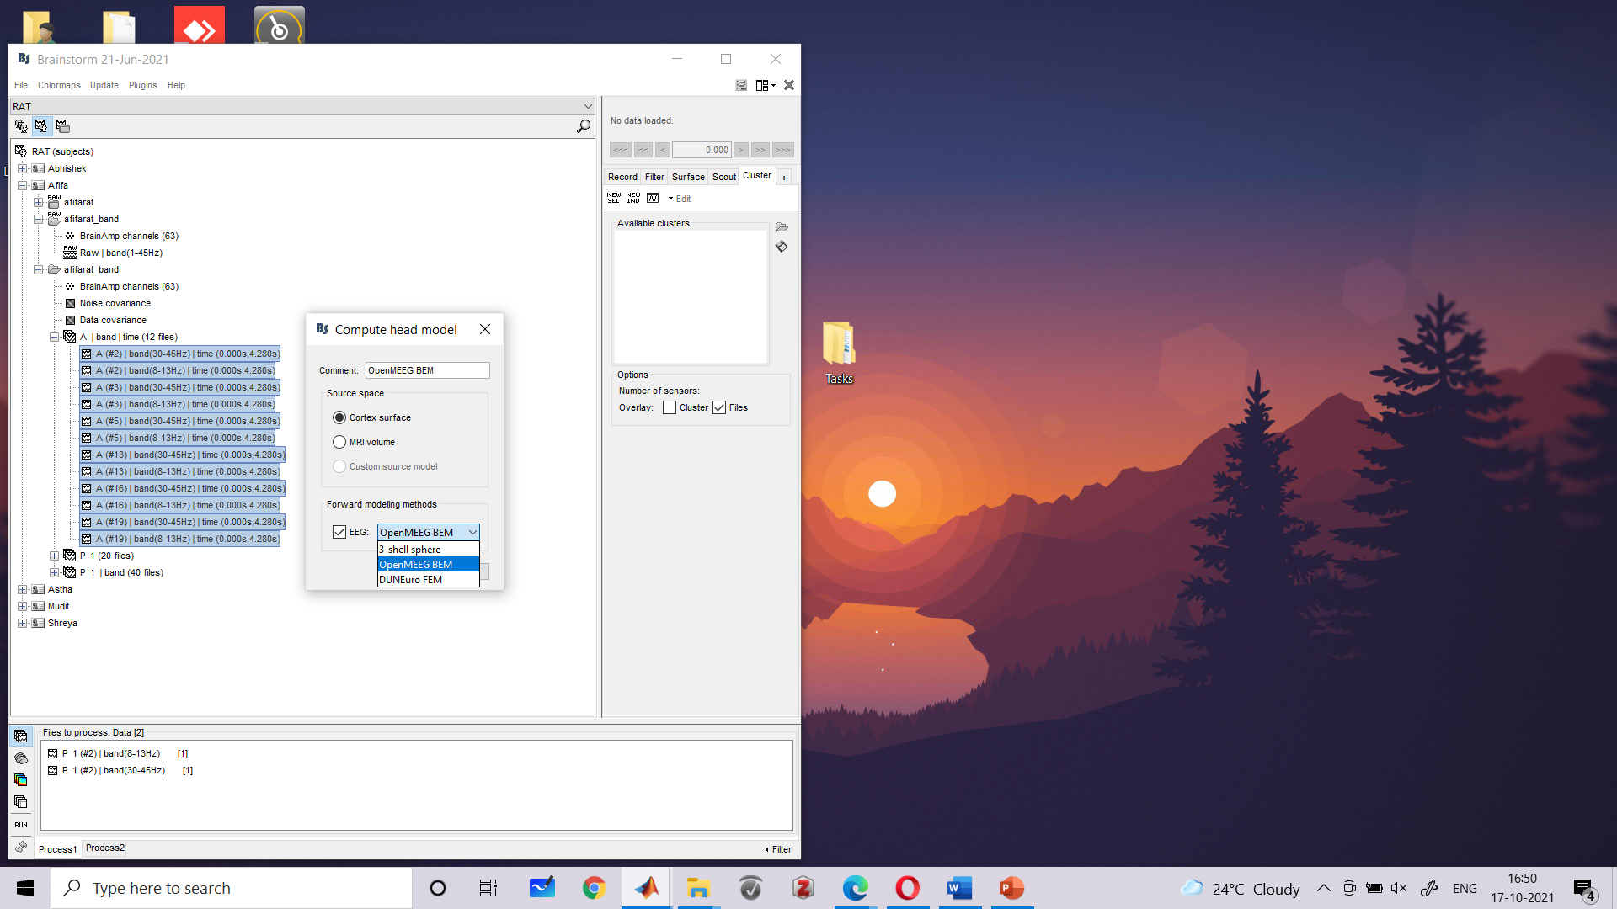
Notes:
Download open meeg bem, follow the instructions on your screen for that. Add to path after downloading it.

Slide 16


Slide 17


Slide 18
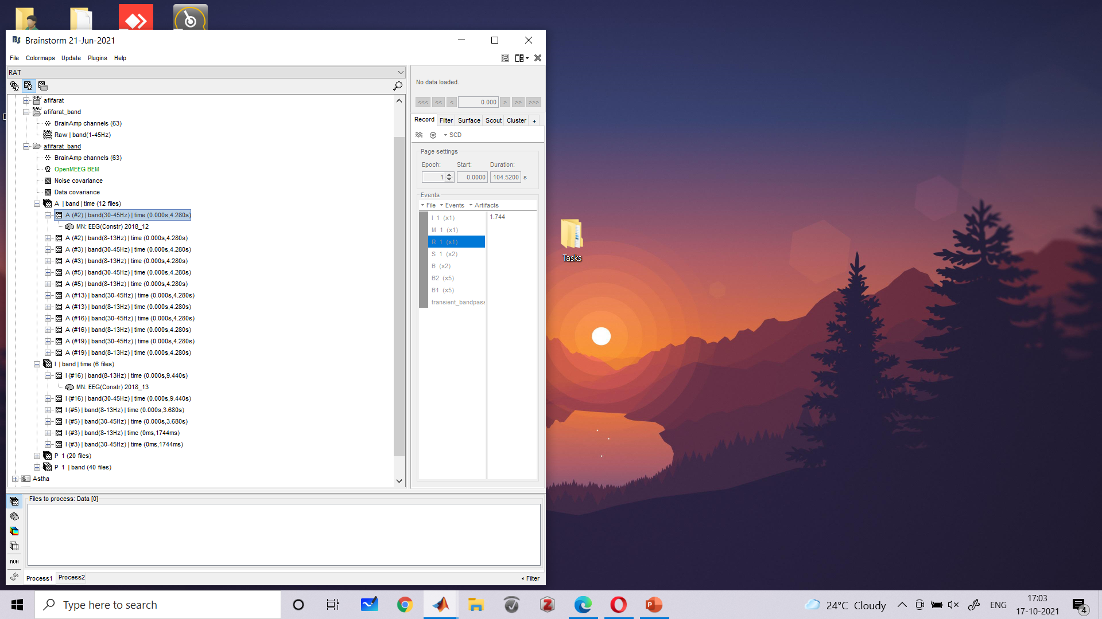

Slide 19


Slide 20
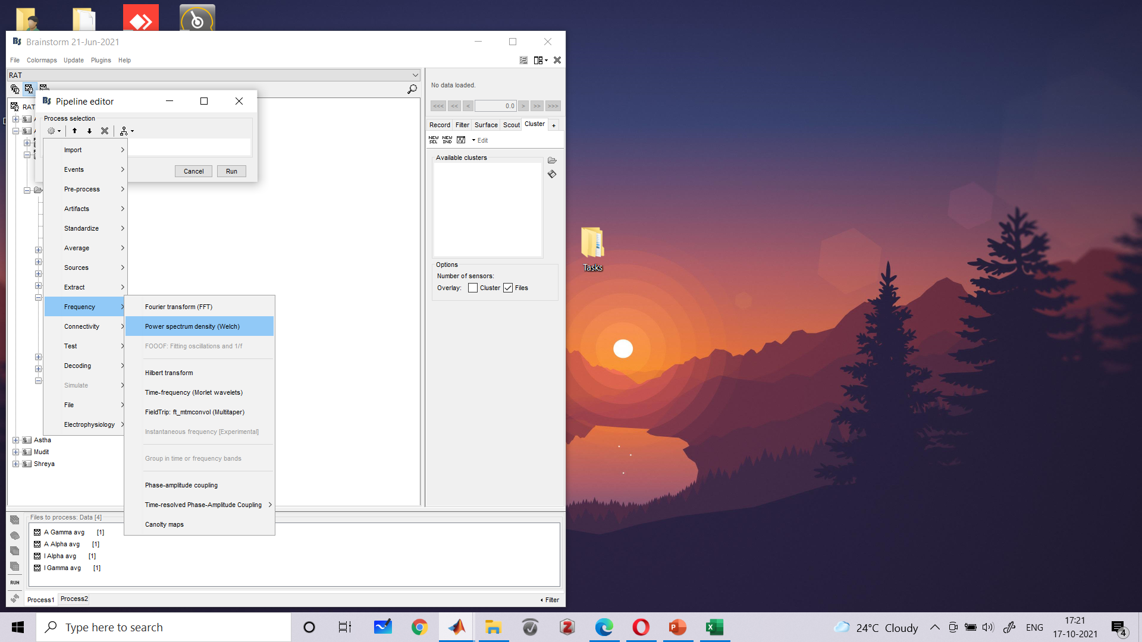
Notes:
PSD

Slide 21
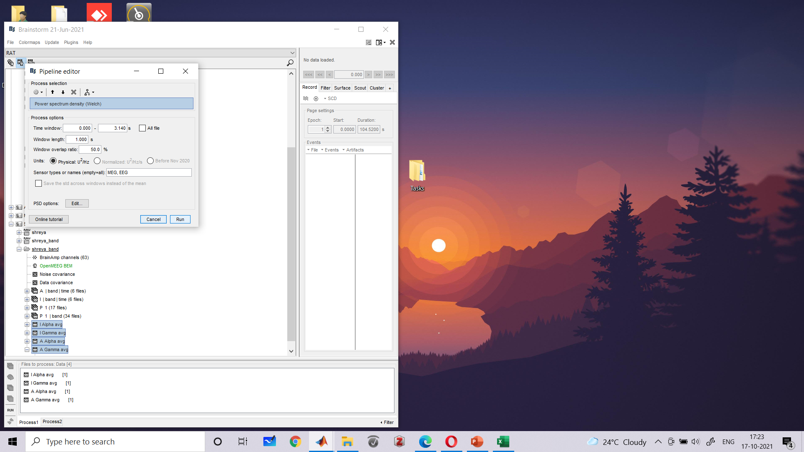

Slide 22


Slide 23
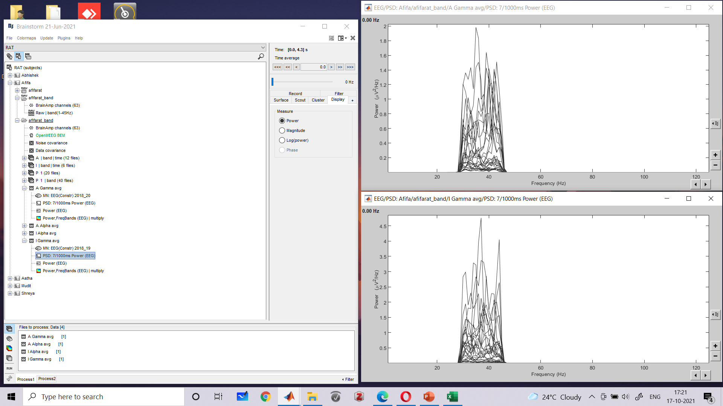
Notes:
PSD RESULT- Power of Gamma (I) > Power of Gamma (A)

Slide 24
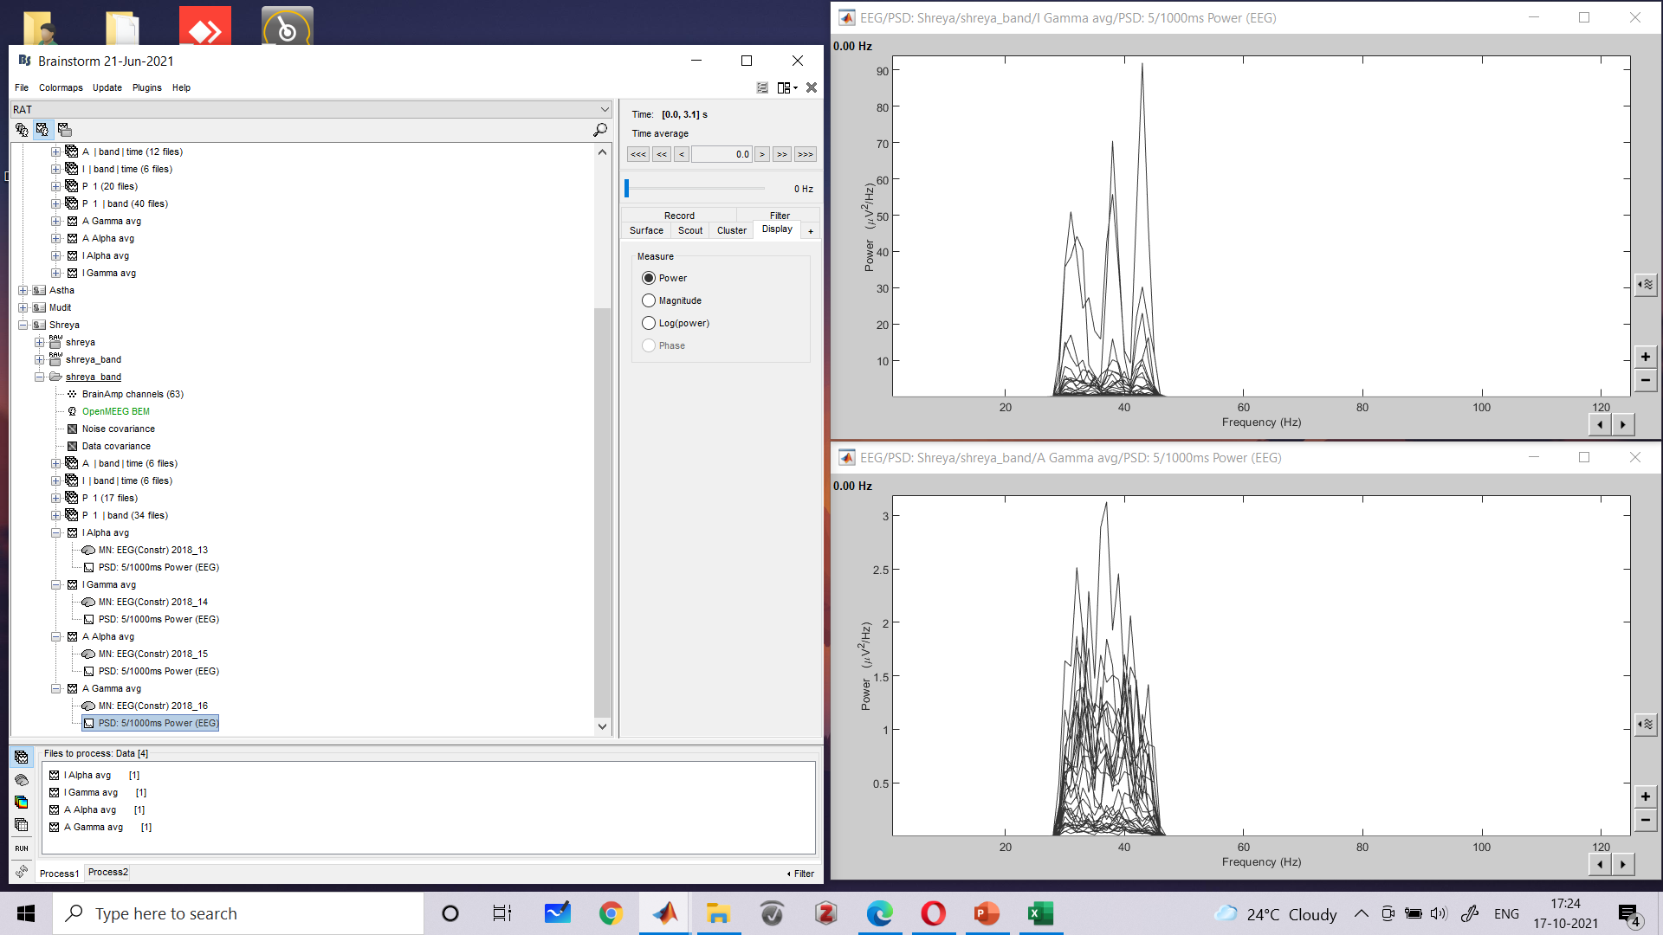
Notes:
PSD RESULT- Power of Gamma (I) > Power of Gamma (A)

Slide 25
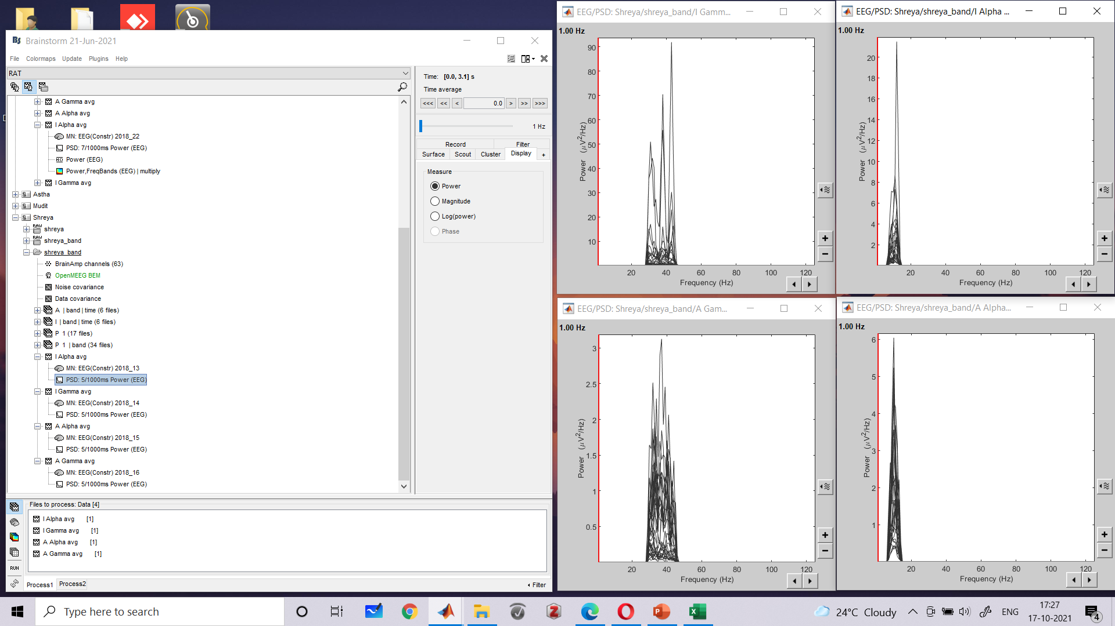
Notes:
Power of Alpha > Gamma in A, while Power of Gamma>Alpha in I

Slide 26
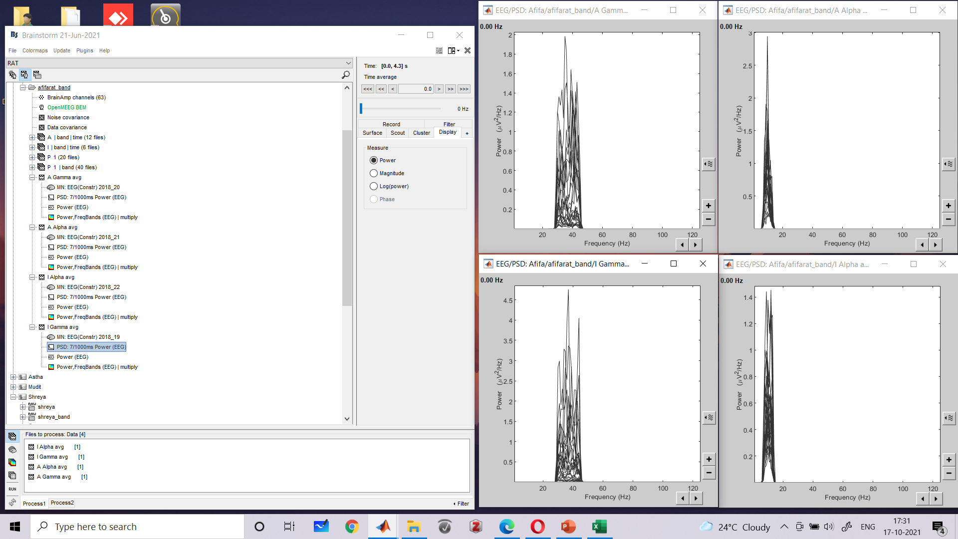
Notes:
Power of Alpha > Gamma in A, while Power of Gamma>Alpha in I

